Slide 1

Social DriveNet: Integrating DDQN with Social Attention for Autonomous Traffic Navigation Leone Lage Perdigão Department of Computer Science University of Bath Bath, BA2 7AY llp31@bath.ac.uk
Notes:
"Good day, everyone. I’m Leone Perdigão and today, I'm excited to present my project titled 'Social DriveNet: Integrating DDQN with Social Attention for Autonomous Traffic Navigation'.

Slide 2
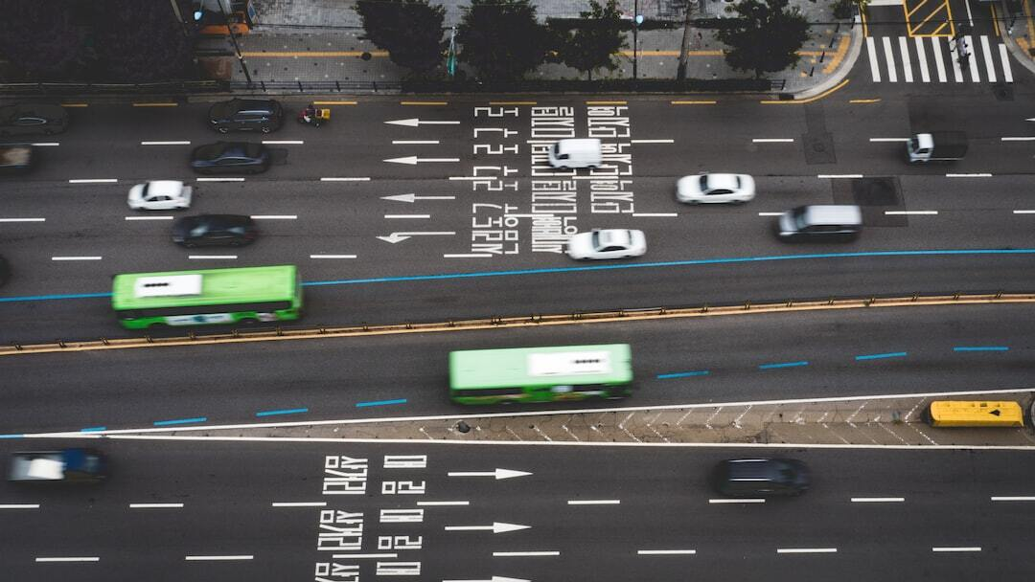

Social DriveNet: Integrating DDQN with Social Attention for Autonomous Traffic Navigation
Introduction: Exploration of enhanced decision-making in dense traffic using advanced reinforcement learning techniques.
Significance: Addresses critical challenges in autonomous driving by improving real-time responses and safety.
Objective: Validate the efficacy of Double Deep Q-Network (DDQN) integrated with social attention for dynamic traffic navigation.
Problem Definition: Dense urban traffic presents a major challenge for autonomous vehicle navigation, requiring highly adaptive and accurate decision-making.
Solution Method: The model utilizes a dual estimator setup to mitigate Q-value overestimations, improving accuracy and stability. Incorporates social attention to dynamically consider the behaviors and positions of surrounding vehicles, enhancing decision-making. Deployed within the 'highway-env' simulation tool, providing a realistic multi-lane highway scenario for testing and development.
Results: The DDQN with social attention showed superior policy optimization and stability in rewards compared to the baseline DQN. Significant improvements in navigation efficiency and safety metrics in dense traffic scenarios. Utilized exponential smoothing and moving averages to demonstrate the robust adaptability and learning efficiency of the DDQN model.
Conclusion: The study validates the effectiveness of integrating DDQN with social attention, marking a significant step in autonomous driving research. Future studies will explore further enhancements in simulation fidelity and the integration of real-world data for more robust models. Continued development in this area has the potential to dramatically improve safety and efficiency in autonomous vehicle navigation.
Photo by Nicki Eliza Schinow on Unsplash
Notes:
This project conducted as part of the Masters in Artificial Intelligence program at the University of Bath explores enhancing decision-making in dense traffic through advanced reinforcement learning techniques. The objective is to validate the efficacy of Double Deep Q-Networks integrated with social attention mechanisms, aiming to improve safety and responsiveness in autonomous driving.”
In this presentation I will give you an overview of the problem, the impact, the solution, and the results.

Slide 3

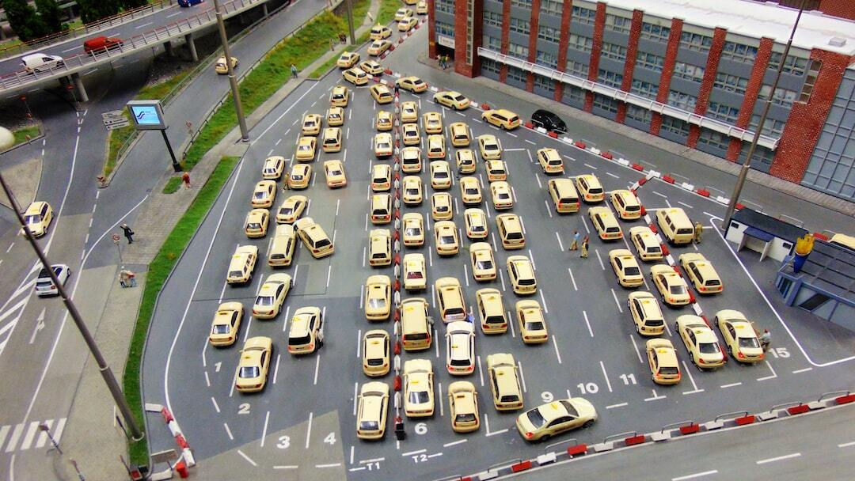
Problem Definition
Traffic Complexity: Dense urban traffic presents a major challenge for autonomous vehicle navigation, requiring highly adaptive and accurate decision-making.
Current Limitations: Traditional models struggle with the dynamic and unpredictable nature of closely-packed urban environments.
Research Motivation: The study explores the potential of Double Deep Q-Networks (DDQN) with social attention to improve traffic navigation accuracy and safety.
Photo by Mika Brandt on Unsplash
Notes:
Slide 2: Problem Definition
"The complexity of urban traffic poses significant challenges for autonomous vehicles, which must navigate safely and efficiently. Traditional models often struggle with the unpredictability of such environments. This work focused on demonstrating how these challenges can potentially be overcome by enhancing the decision-making capabilities of autonomous systems through an innovative approach"

Slide 4

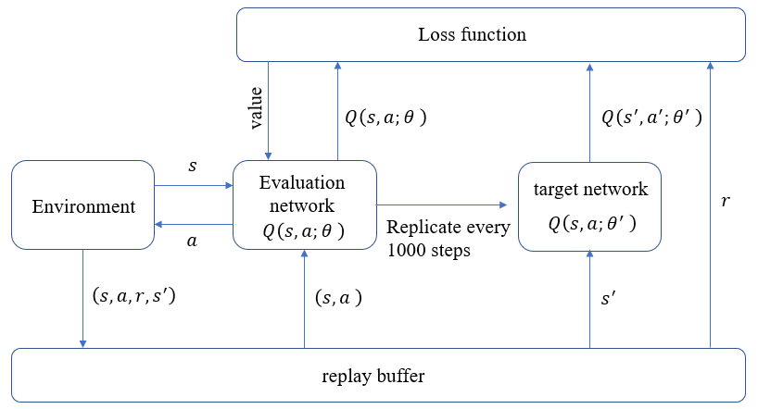
Solution Method
Inspiration: "Social Attention for Autonomous Decision-Making in Dense Traffic” (Leurent and Mercat, 2019).
DDQN Architecture: The model utilizes a dual estimator setup to mitigate Q-value overestimations, improving accuracy and stability. This model was compared with a standard DQN model.
Social Attention: Incorporates social attention to dynamically consider the behaviors and positions of surrounding vehicles, enhancing decision-making.
Simulation Environment: Leveraging the 'highway-env’ Gym environment, providing a realistic multi-lane highway scenario for testing and development.
Souce: Double DQN Architecture. Cheng, Weijun & Liu, Xiaoshi & Wang, Xiaoting & Nie, Gaofeng. (2022). Task Offloading and Resource Allocation for Industrial Internet of Things: A Double-Dueling Deep Q-Network Approach. IEEE Access. PP. 1-1. 10.1109/ACCESS.2022.3210248.
Notes:
Slide 3: Solution Method
"To tackle these challenges, a Double Deep Q-Network with a social attention mechanism was implemented inspired by the paper "Social Attention for Autonomous Decision-Making in Dense Traffic” from Leurent and Mercat in 2019.
This model not only reduces overestimations in Q-values, improving both accuracy and stability, but also dynamically incorporates the behaviors of surrounding vehicles into decision-making.
This advanced model was also compared to a standard DQN model that served as a baseline.
All simulations were conducted in the 'highway-env' environment from Gym, which provides realistic traffic scenarios on a multi-lane highway.”

Slide 5

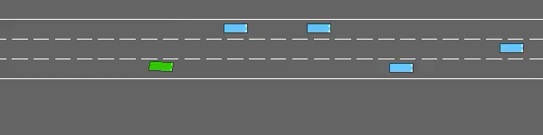
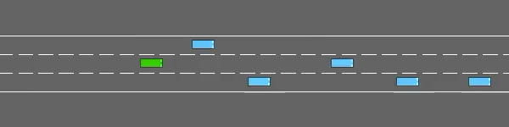
Results
Baseline Model
Performance Metrics: The DDQN with social attention showed superior policy optimization and stability in rewards compared to the baseline DQN.
Model Comparison: Significant improvements in navigation efficiency and safety metrics in dense traffic scenarios.
Data Analysis: Utilized exponential smoothing and moving averages to demonstrate the robust adaptability and learning efficiency of the DDQN model.
DDQN Model
Notes:
Slide 4: Results
”My findings were quite promising. The DDQN model with social attention outperformed the baseline DQN model across various metrics. It demonstrated superior policy optimization, stability in rewards, and significant improvements in navigation efficiency. These results were visualized through data analysis techniques like exponential smoothing and moving averages, highlighting the model’s robust adaptability and learning efficiency."

Slide 6
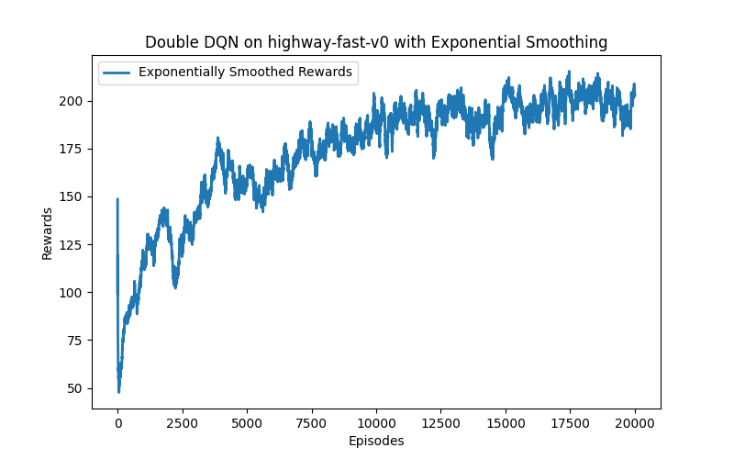
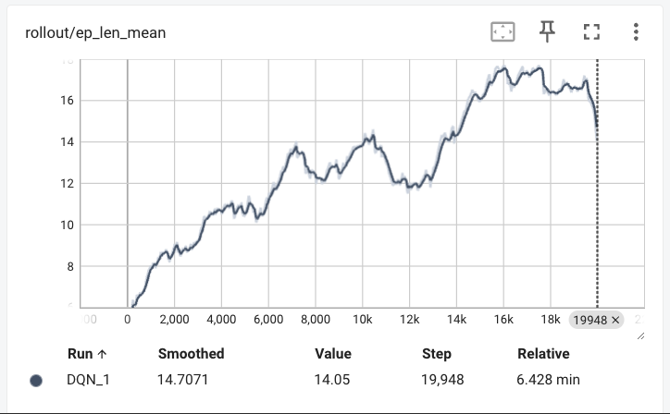
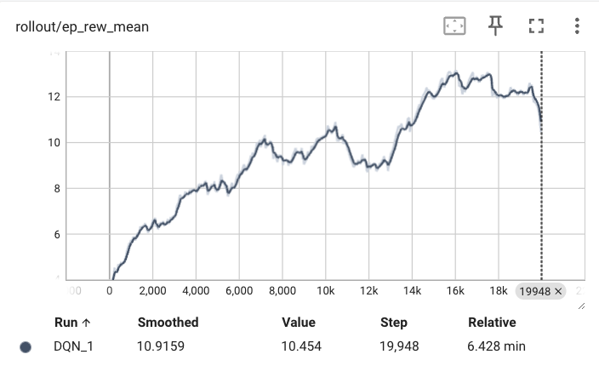
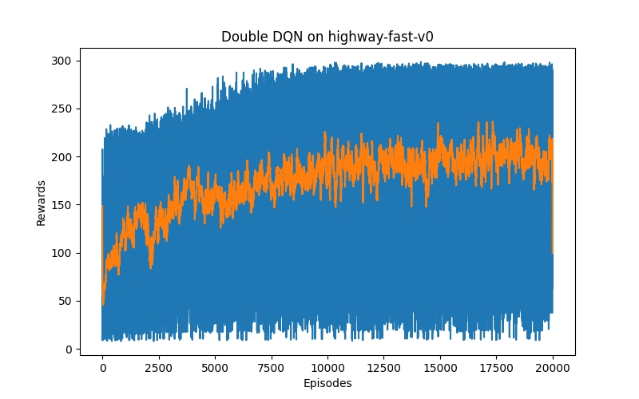
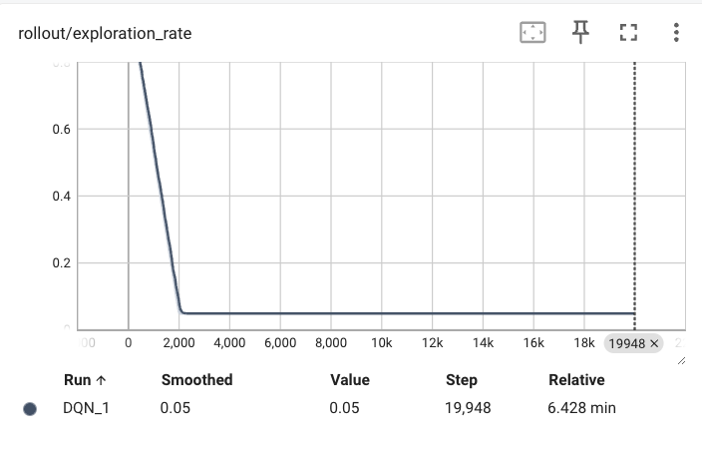

Results
Baseline Model
DDQN Model
Notes:
Here, you can also quickly see the baseline model’s results, including the episode length mean, rewards and exploration rate over the epsiodes.
On the right, I summarised the results from the DDQN model, we are can clearly see a significant superior performance, especially in the rewards accumulation overtime.

Slide 7

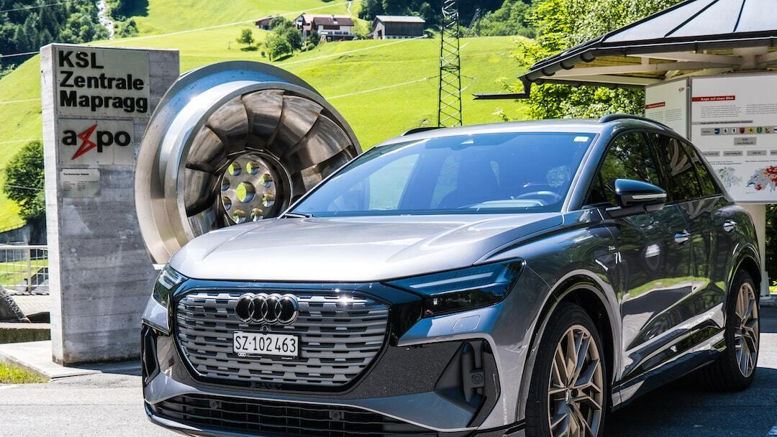
Conclusion and Future Directions
Impact of Findings: The study validates the effectiveness of integrating DDQN with social attention, marking a significant step in autonomous driving research.
Future Research: Future studies will explore further enhancements in simulation fidelity and the integration of real-world data for more robust models.
Technological Advancements: Continued development in this area has the potential to dramatically improve safety and efficiency in autonomous vehicle navigation.
Photo by Matthias Speicher on Unsplash
Notes:
Slide 5: Conclusion and Future Directions
"In conclusion, our study validates the effectiveness of integrating DDQN with social attention, a significant advancement in autonomous vehicle technology. Looking ahead, we aim to further enhance simulation fidelity and integrate real-world data to develop even more robust models. The ongoing development in this field holds the potential to dramatically improve both the safety and efficiency of autonomous vehicle navigation."
"Thank you for your attention. Don’t hesitate to reach out if you have any questions about this project"

